Slide 1
SMART TRAFFIC SYSTEM
A STEP TOWARDS SMARTER WORLD

Slide 2
NEED
Road traffic accidents kill more than 120 lakh people and injure more than 50 Crore people worldwide every year. Everyday about 6600 deaths and 3300 serious injuries occur due to RTAs. The global annual cost due to RTA s is a whopping 2,30,000 million US dollars. Unfortunately India has the dubious distinction of having the worst record of road safety in the world.
SOME ALARMING STATISTICS FOR INDIA
In India, 1,20,000 people die and 12,70,000 sustain serious injuries every year in Road Traffic Accidents.
There is one death on the Indian road every six minutes and this is expected to escalate to one death every three minutes by 2020
India accounts for about 10% of road accident fatalities worldwide.

Slide 3
OBJECTIVE
TO DESIGN SMART TRAFFIC LIGHTS THAT WILL REDUCE THE CHANCES OF TRAFFIC RULE VIOLATION AND KEEP RECORD OF VIOLATORS AS WELL WHICH IS COST EFFECTIVE AND RELIABLE.
BEST SUITED TO INDIA’S TRAFFIC SYSTEM.
EFFECTIVE USE OF HUMAN RESOURCES.

Slide 4
FEATURES
RELIABLE (MICROCONTROLLER’S BRAIN) : UNDOUBTEDLY USE OF MICROPROCESSORS IN DAILY USED CONTRIVANCE LIKE MICROWAVE OVENS ,WASHING MACHINE,BIKES,CARS IS THE RESULT OF IMMEDIATE,ACCURATE,INTELLIGENT AND CONSISTENT RESPONSE OF THE MICROPROCESSOR /MICROCONTROLLERS WHICH ACT AS CPU IN THESE DEVICES.
OPERATES IN REAL TIME (FASTER RESPONSE) : HASTY COMEBACK FROM MICROPROCESSOR REDUCES CHANCES OF DELAY.
LOW POWER CONSUMPTION : REQUIRES 10V TO 12V DC FOR ITS OPERATION (SHOCK LESS).
SELF MONITERING AND CONTROLLING(AUTOMATIC): PRESENCE OF MICROCONTROLLER MAKES AN INTELLIGENT DEVICE.
COST EFFECTIVE : REDUCED WIRING AND LOW MAINTAINANCE

Slide 5
TECHNOLOGY PLATFORM
The most reliable, fast, accurate and robust digital technology is used here for designing of solution. It uses a brain of 8-bit Microcontroller technology.
PIC16F887 Microcontroller is used.
Embedded C Language is to be used for accomplishment of the goal.
Real time sensors are employed to yield better performance of the designed solution.
Single PCB (Printed Circuit Board) is used.
Textual interfacing by means of LCD .

Slide 6
WORKING:
WHENEVER THE TRAFFIC LIGHTS GOES RED ,THE MICROCONTROLLER WILL ACTIVATE/RUN THE RFID SENSOR (RADIO FREQUENCY IDENTIFICATION) AND WHEN ANY VEHICLE CROSSES OR RUNS THE RED LIGHT,ALL ITS DETAILS INCLUDING REGISTRATION NUMBER,REGISTERED NAME ETC WILL GET RECORDED .THIS DATA CAN LATER BE USED TO TAKE ACTION AGAINST THE SAME.THE RFID SENSOR KEEPS ON RUNNING TILL THE TRAFFIC LIGHT IS RED .IT WILL GO OFF FOR THE REST OF THE TIME .
HARDWARE USED:
PIC16F887-MICROCONTROLLER, SWITCHES, LCD, BUZZER, LEDs, DIODES ,BIPOLAR TRANSISTOR BC547, RESISTERS ,CRYSTAL OSCILLATOR and RF TRANSMITTER-RECEIVER MODULES

Slide 7
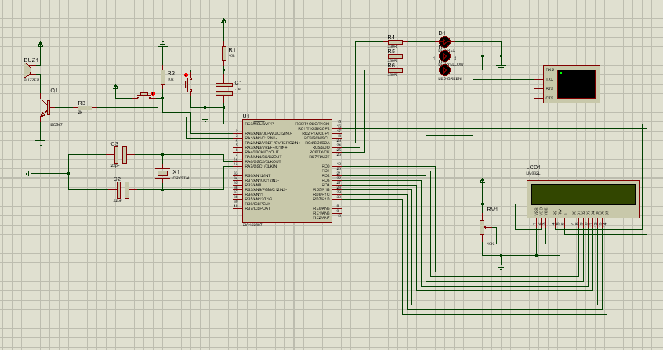
CIRCUIT USED

Slide 8
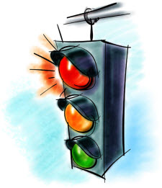
BLOCK DIAGRAM
TRAFFIC LIGHT
MICROCONTROLLER
RFID SENSOR
LCD

Slide 9
CONTROL FLOW
START THE DEVICE
AFTER 45 SECONDS
AFTER 30 SECONDS
CHECKS THE TRAFFIC LIGHT
AFTER 3 SECONDS
RED LIGHT
YELLOW LIGHT
GREEN LIGHT
TURN RFID SENSOR ON
RFID REMAINS OFF
RFID REMAINS OFF

Slide 10
ADVANTAGES
REDUCES HUMAN AND ECONOMICAL LOSSES.
SMART TRAFFIC LAWS ENFORCER.
EASY TO IMPLEMENT.
LESS PRONE TO ERRORS .

Slide 11
REFERENCES
http://www.ioaindia.org/ROADTRAFFICACCIDENTS.pdf

